Slide 1
St Michael’s PTA
AGM
Wednesday 17th April 2024

Slide 2
Agenda
The role of the PTA
PTA Fundraising 2023/24
Financial Update
Proposed amendments to the PTA constitutions with vote to approve or reject
Dissolution of current committee
Election for the 2024/25 committee
Future Spending priorities
Fundraising ideas
A.O.B.

Slide 3
Introduction
St Michael’s PTA, Enfield is a registered charity
(Reg No: 1152475)
Our written constitution states
  The purpose of St Michael’s PTA, Enfield is to advance the education of pupils in the school by:
  Engaging in activities or providing facilities or equipment which support the school and advance the education of the pupils
  Developing effective relationships between the staff, parents and others associated with the school
Notes:
Thanks for coming etc
Thanks for coming. Blurb about how we are all members of the PTA
Brief mention of what PTA does – i.e. just a slide of Constitution statement.
Quick mention of things funded in the past.
Then also emphasise not just about raising funds but also helping parents and teachers to communicate

Slide 4
EVENTS

Slide 5
PTA activities 2023-24
Easter Egg Trail
Summer Disco
Summer Fayre
Race Night
Cricket Club Fireworks
Winter disco
Wreath Making
Festive Week
Christmas Cards
Break The Rules day
Spring disco
Talent Show
Year Group Cake Sales
Used Uniform

Slide 6
PTA Events to the end of the school year 2024
Events still to come:
Bacon Bars – 15 to 19 April
Summer disco – 7 June
Summer Fayre – 22 June
Cake Sales (Year 1 & Early Years)

Slide 7
FINANCE

Slide 8
Finance
Income
Main profits from events
Expenditure
Future spending priorities

Slide 9
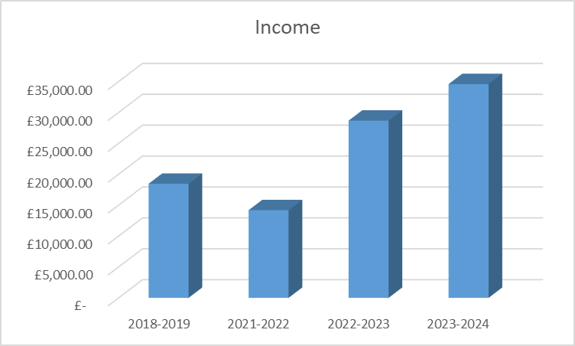
Income
Notes:
From April 2023 to April 2024, PTA events alone raised £37,388.00. We spent £10,193.00 staging the events and so the events alone raised £27,195.00.
This does not include F&L sponsorship of £2500.00, corporate community match funding of £2370.00 and £255.18 from Easyfundraising.
This gives us a grand total raised of £32,320.18.
Footnote: Including events, sponsorship, community match funding, Easyfundraising and interest we banked £42,539.00.

Slide 10
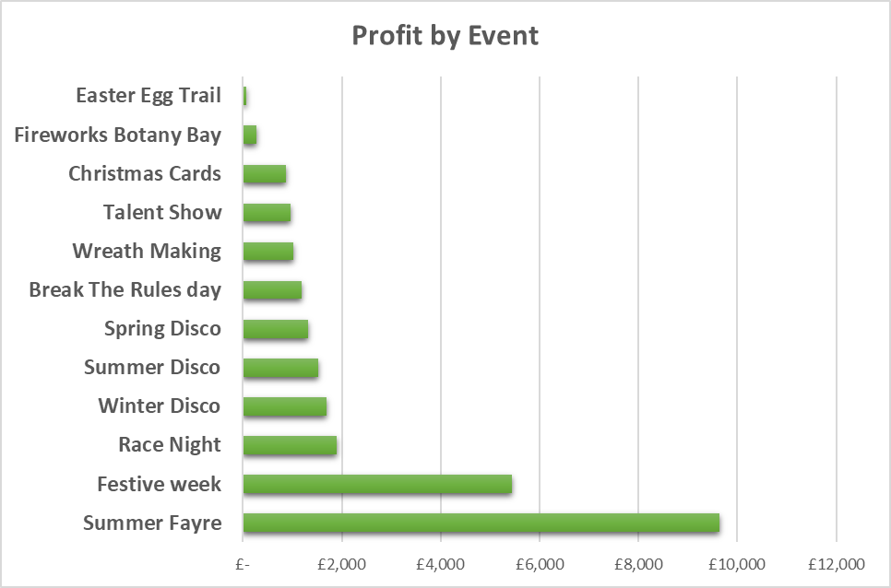
Profit by Event

Slide 12
What the PTA have funded 2023-24
Small grants (Reception) £80.00
Year 6 leavers’ party donation £250.00
Year 6 leavers’ bibles £500.00
Royal Opera House visit £500.00
Year 5 instrumental lessons £2,500.00
iPads £3,693.00
IT equipment £20,000.00
TOTAL SPEND £27,523.00

Slide 13
COMMITTEE

Slide 14
The Role of the Committee
There are six positions:
Chair, Treasurer, Secretary and the vice roles of each.
The committee members are trustees of the charity.
The committee usually meet once a term.
The committee discuss and make decisions on all money
raised and spent by the PTA which includes small grants,
ad-hoc funding, etc.
Notes:
Committee Roles - Chair
The Chair provides leadership for the committee, sets the agenda for meetings and manages meetings in line with the agenda.
The Chair should ensure that issues are properly debated and an agreement is reached. Some committee members will be better at expressing themselves than others; it is important that the Chair welcomes contributions from all members of the committee so that everyone feels involved. New members of the committee may feel nervous at first. The Chair should welcome all new members, introduce them to the other members and encourage them to play an active part in the discussions.
Occasionally, disagreements arise. The Chair should remain impartial, call the meeting to order without upsetting the parties involved, and make sure that the committee's decisions are not hindered in any way.
The Chair needs to work closely with the Treasurer and Secretary to ensure that the association is run effectively. The Chair can be a signatory for the association's bank account, along with either the Treasurer or Secretary or other elected committee member.
make meeting & event arrangements
co-sign cheques as required
write the annual report with the Treasurer
Committee Roles - Secretary
deal with correspondence
prepare agendas
call meetings - giving plenty of notice
keep a record of attendance at meetings
take notes during meetings
ensure that enough committee members are present to make the meeting quorate (this number is defined in the constitution)
write up the minutes of meetings
distribute minutes to all the committee
Committee Roles - Treasurer
Treasurer is responsible for day to day admin of financial records and procedures as well as the banking and handling of money at PTA events.
maintain accurate and detailed financial records
present a financial report at each meeting
liaise with the bank
make approved payments
provide and account for cash floats at events
charity registration and Gift Aid
pay agreed expenses
prepare annual accounts and liaise with the independent examiner of accounts
ensure the committee has agreed appropriate procedures for the handling of financial matters

Slide 15
Dissolution of Current Committee 2023-24
Chair Phil Wren
Treasurer David Lawrence Myers
Secretary Nicky Baldwin
Vice Chair Carly Taylor
Vice Treasurer Marina Cant
Vice Secretary Ozen Constantinou

Slide 16
Election of New Committee
2024-25
Chair Phil Wren
Treasurer David Russell
Secretary Nicky Baldwin
Vice Chair Carly Taylor
Assistant Events Coordinator Sammy Shaw
Vice Secretary Victoria Mundy
Notes:
3 Nominations for Vice Secretary
Sonia Allen
Danielle Shap
Salma Bheekhun

Slide 17
Future Spending priorities identified and agreed with the school for 2024-25
Proposed spending…
Year 6 Bibles
Year 5 instrumental lessons
Theatre (ROH / Globe players)

Slide 18
Future fundraising ideas

Slide 19
Any other business

Slide 20
A very big Thank You
2023-24 PTA committee members
Class reps
Parent volunteers
Mrs Bacon
Teachers
Office staff
Mr Johnson
F&L Kitchens
Atkinson’s Residential

